Slide 1
Line and Portrait
Looking at line

Slide 2
Line
A line is a mark that spans the distance between two points.

Slide 3
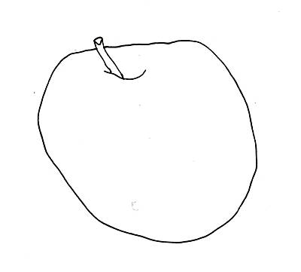
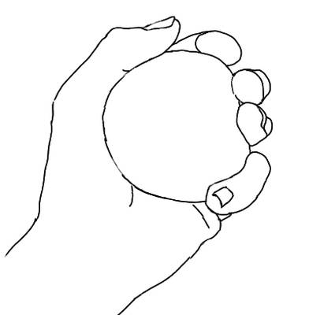
Contour Line
A line the defines an edge. It’s an outline.

Slide 4
Implied Line
A line that connects in your head. It isn’t a solid line. It’s a suggestion of a line.

Slide 5
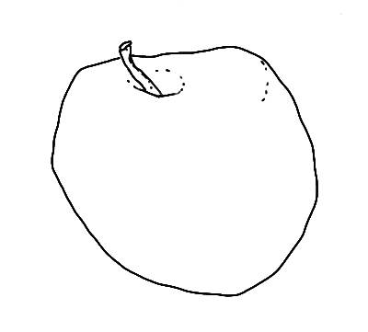
Implied Line
Implied lines can help us show that things are not flat. They make things look three-dimensional (3-D).

Slide 6
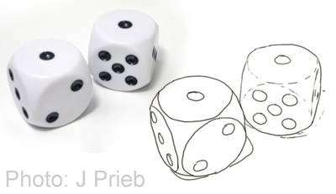
Contour vs. Implied

Slide 7
Connection to the Unit
We are going to start to draw faces next week. Completing contour drawings will help us to get better at looking and at drawing. We can’t draw a realistic face without the basics.

Slide 8
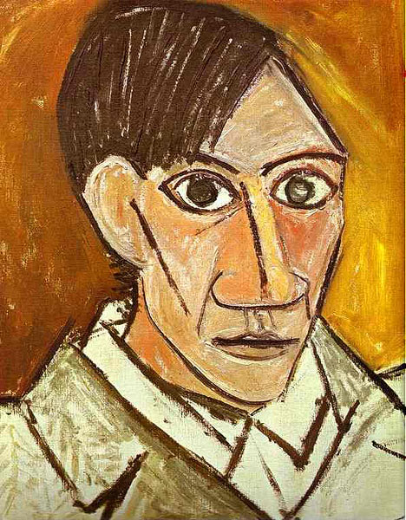
Examples of line in art
LOOK at this Self-Portrait by Pablo Picasso for 7 seconds
DESCRIBE: What kinds of lines do you see? Implied? Contour?

Slide 9
Critique
LOOK at this Self-Portrait by Egon Schiele for 7 seconds
DESCRIBE: What kinds of lines do you see? Implied? Contour?

Slide 10
Work Time
Choose one object
Fold your paper in half
Complete a line drawing of your object on one half of the paper
Move the object and create another contour line drawing on the other half of the paper
Repeat on the back

